Slide 1
Presentation link: Presentated by Lei Fang and Dong Li Team name: iHealth TA : Taylor Startin - tstartin3 Team member: Lei Fang, lfang40, lfang40@gatech.edu Dong Li, dli355, dli355@gatech.edu Xue Liang, xliang70, xliang70@gatech.edu Lu Wang, lwang496, lwang496@gatech.edu Xiaoming Su, xsu39, xsu39@gatech.edu Bo Lin, blin76, blin76@gatech.edu

Slide 2
Birth Certificates on FHIR
Xiaoming Su, Lu Wang, Lei Fang, Dong Li, Xue Liang, Bo Lin
Team iHealth
12/01/2017

Slide 3
Overall Project Goals And Objectives
The current birth registration problems
Birth certificate/birth registration, as one of the most important documents, however, the collection and submission of birth certificate information to state vital statistics agencies is currently the responsibility of birth certificate clerks, typically staff in medical records departments of hospitals. This information is hand-written onto a facility worksheet which caused time-consuming and error-prone.
The end users requirement and our solution
Our team (iHealth) identified problems thoroughly by interviewing prospective end users to understand their requirements. Our team realized that a way to overcome this challenge is to develop a web-based application-- an electronic birth registration system which can abstract clinical information from the records of both the mother and the newborn and submit to the state health department birth certificate registry in an efficient an accurate way.

Slide 4
Overall Project Goals And Objectives Cont.
The scope of this project would be to develop the FHIR resource mappings and birth certificate logic to support a SMART-on-FHIR application for birth certificate clerks
Clerk in the EHR would launch the birth certificate app
App would then fetch the necessary data elements
Programming Languages
Web: HTML, CSS, JavaScript, PHP
Database: MySQL
Backend: Java

Slide 5
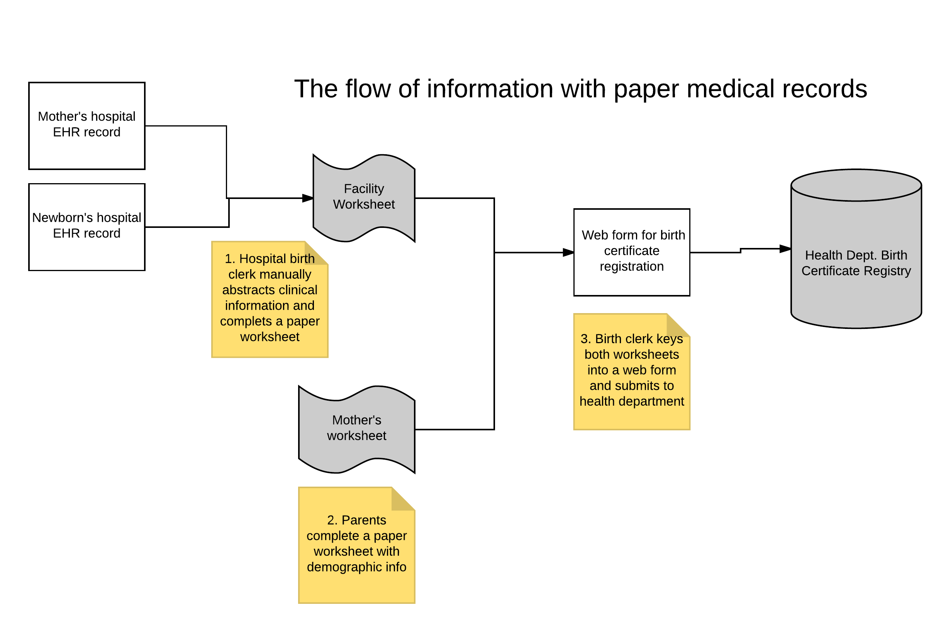
Architectural Diagram
Image was provided by Dr. Ducan

Slide 6
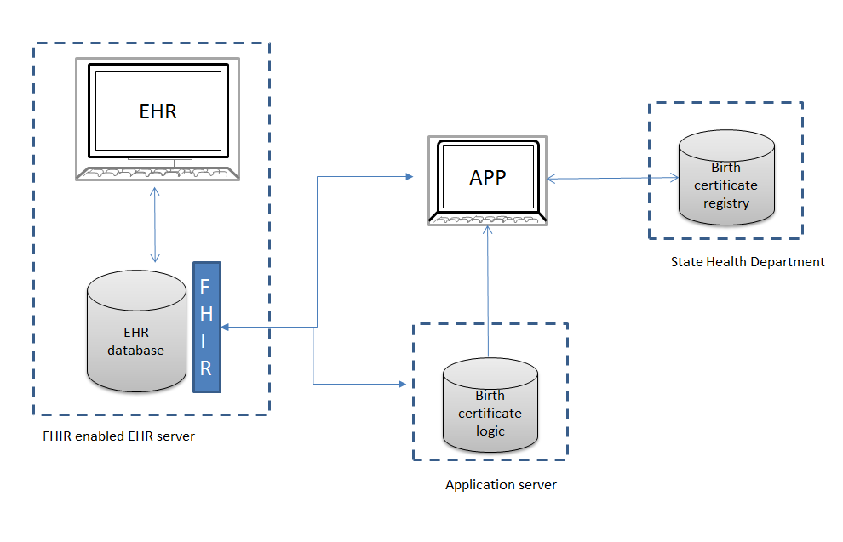
Project Overview
Steps:
Choose a subset of birth certificate information after reviewing the standard birth certificate.
Map birth certificate data elements for each discrete subset identified in (1) to FHIR resource definitions.
Develop logic for the application to translate EHR values to birth certificate values.
Develop a SMART-on-FHIR module with logic specific to the subset that will either pre-populate the birth form or otherwise provide the birth clerk with decision support.
Image was provided by Dr. Ducan

Slide 7
Procedure
Designed Website :
Use HTML to setup the main page of the app
The authorized user need to register and set up an account
Identified app workflow
Started to prepare Database (ongoing task)

Slide 8


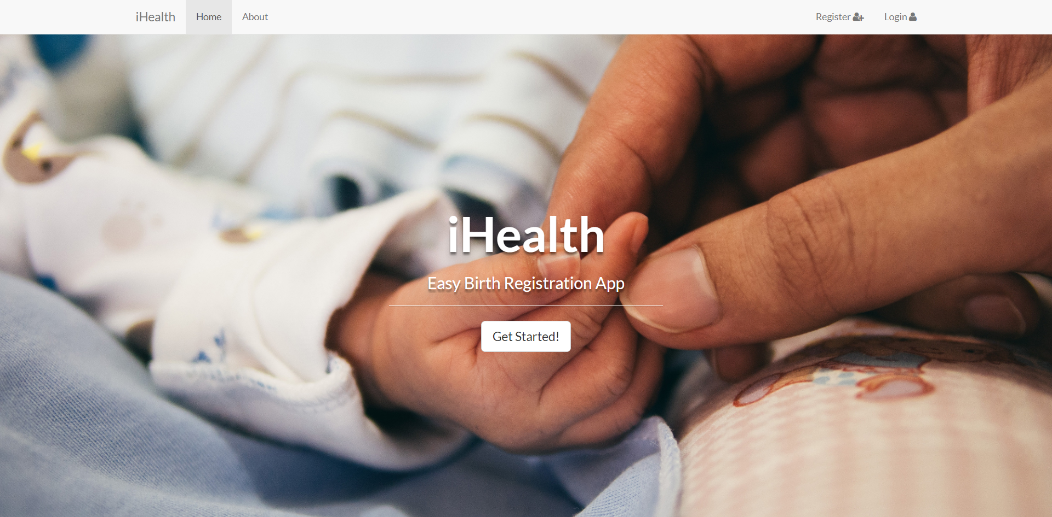
Home
Web Design
Login
Register

Slide 9
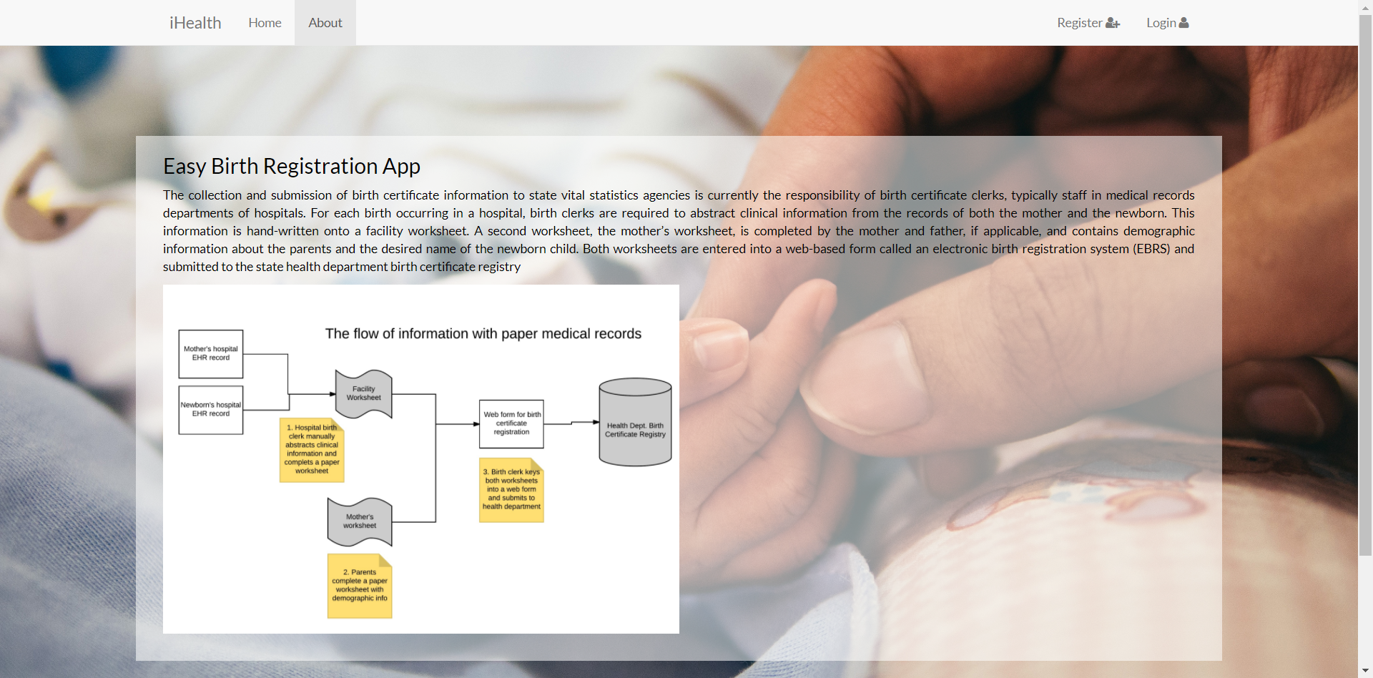
Web Design
Notes:
In order to let the end users easily understand and use the app. We have adopted the following strategy 1) We follow the principle of efficient and user-friendly design the interface to report all of birth certificate; 2) we offered a very detailed /help/tutorial documentation.

Slide 10
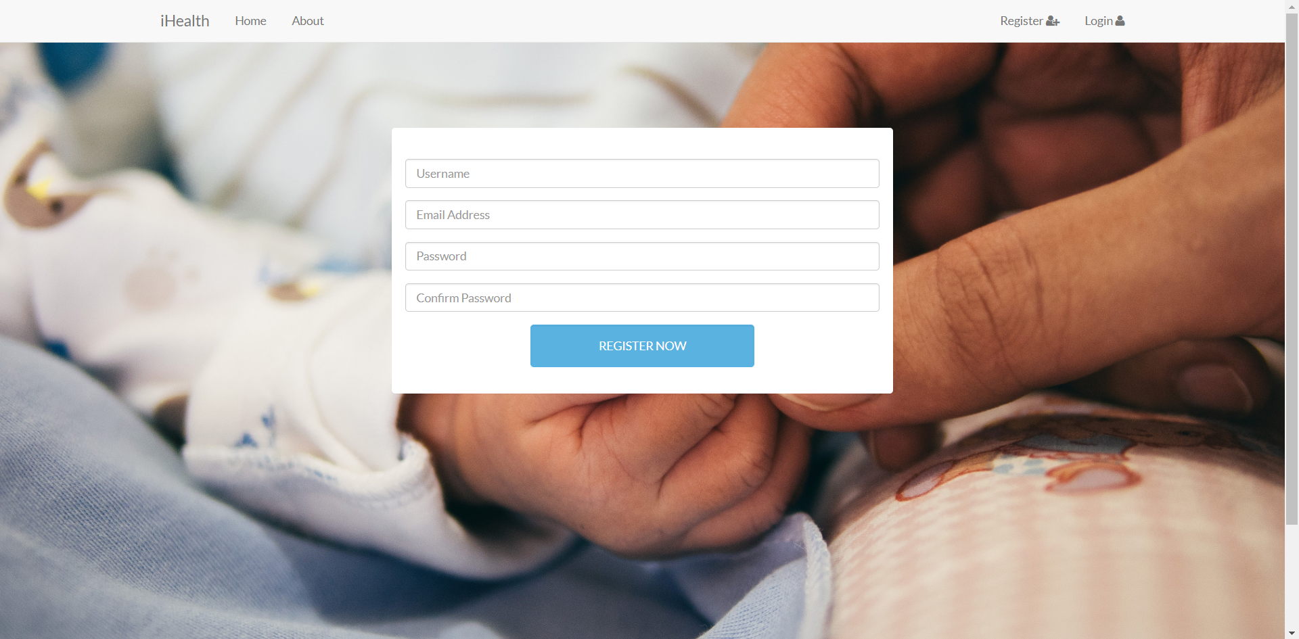
Web Design

Slide 11
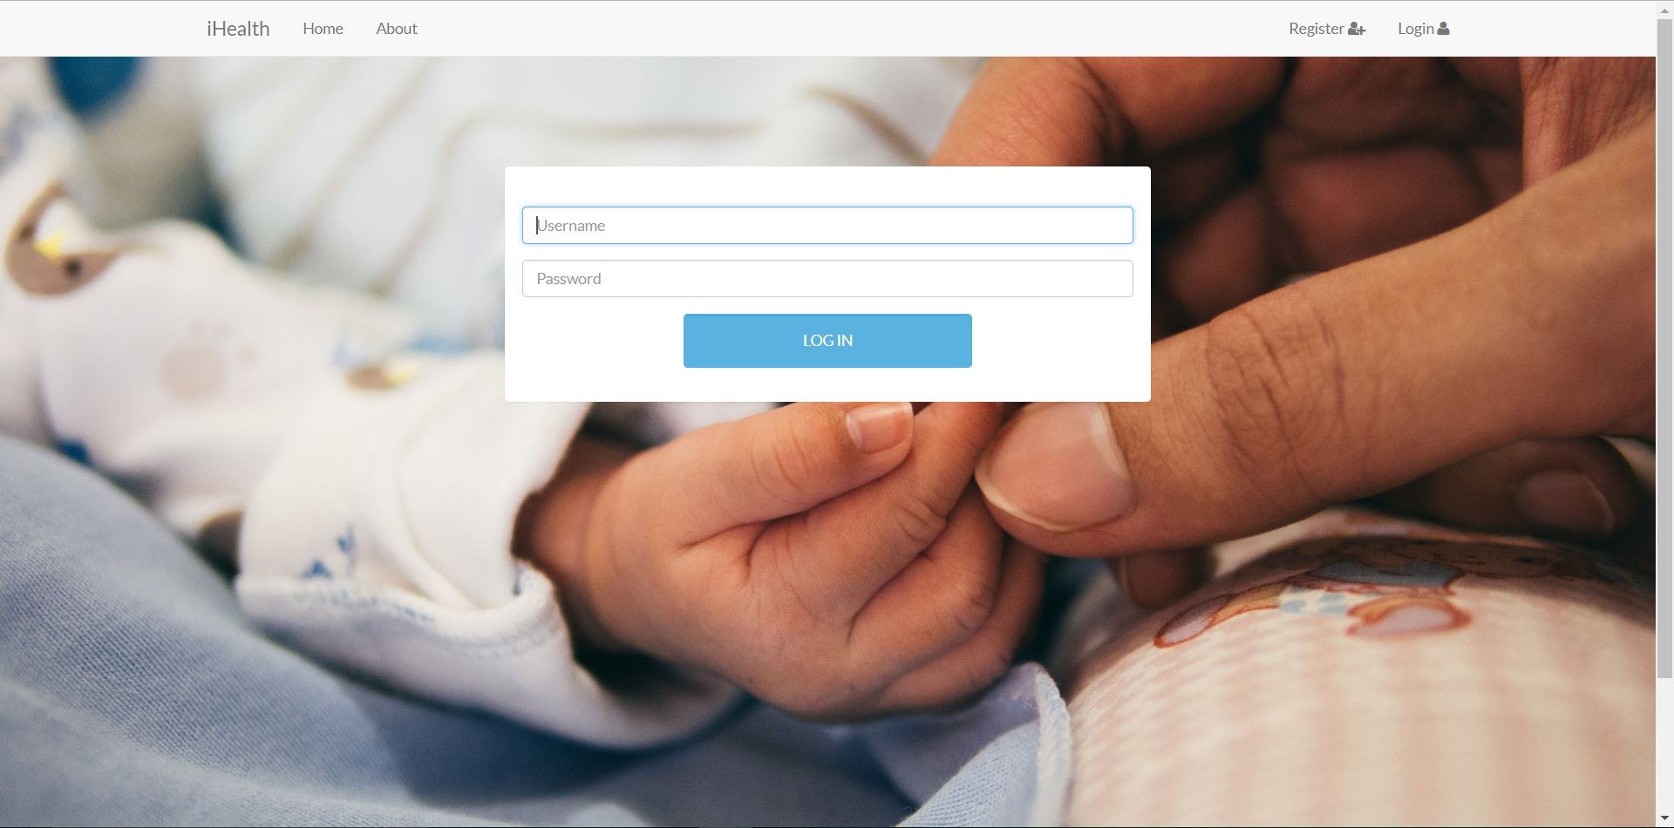
Web Design

Slide 12
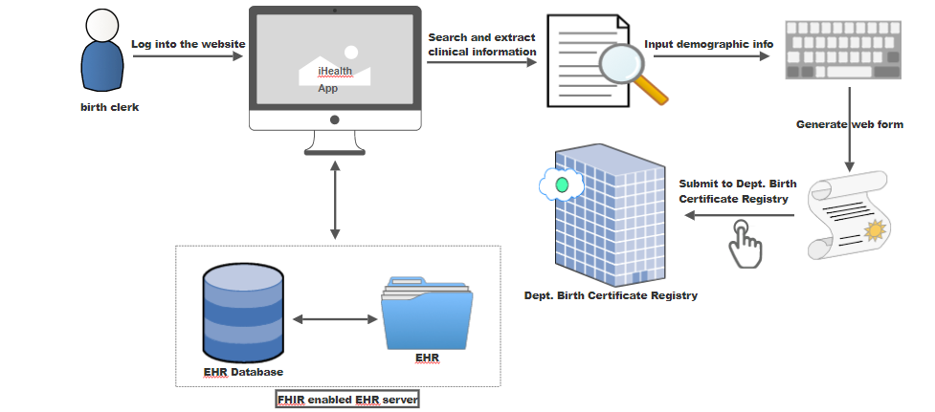
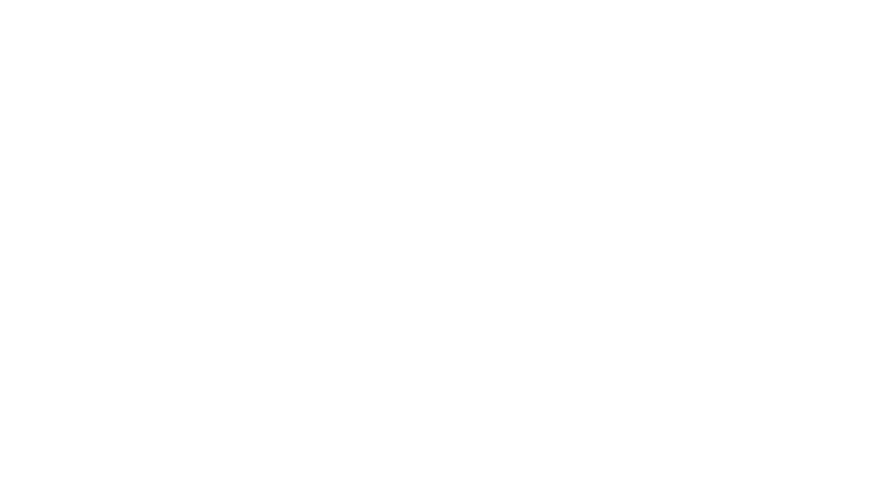
General Workflow

Slide 13
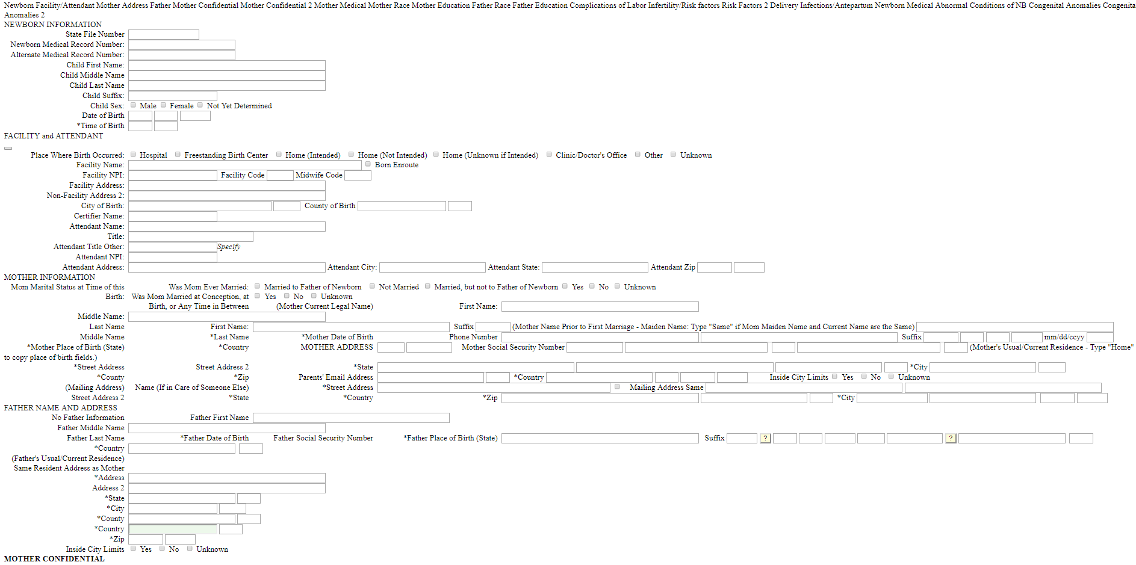
Database Preparation: Data selection

Slide 14
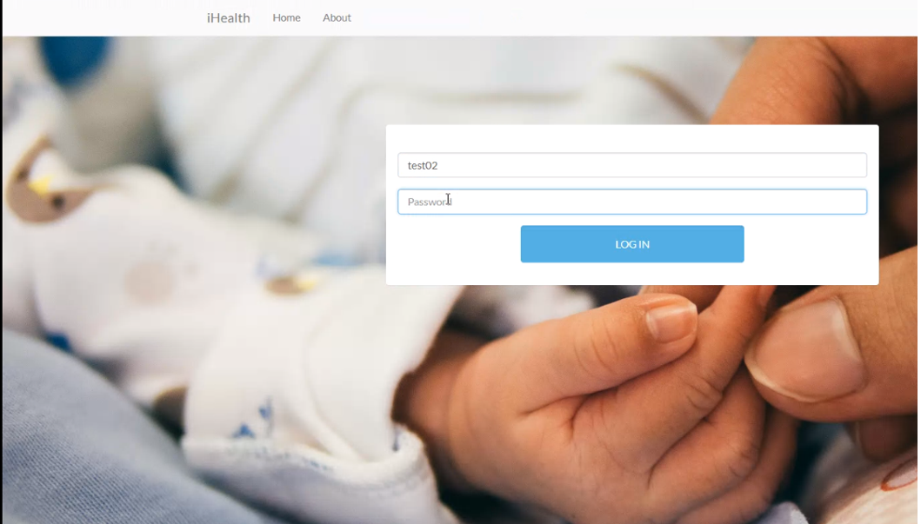
App’s Key Functions

Slide 15
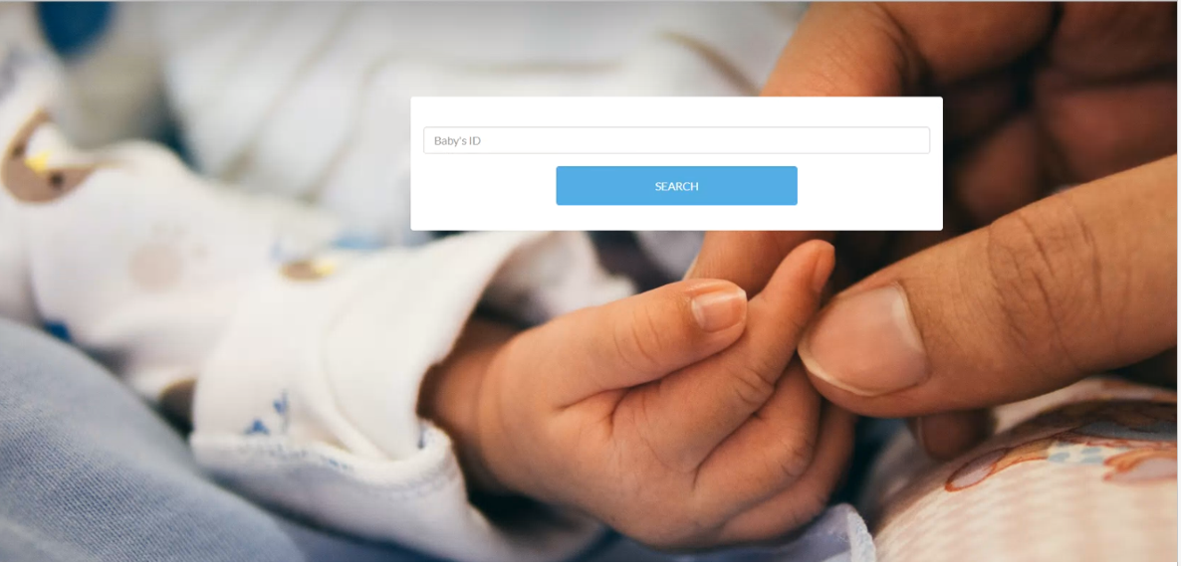
App’s Key Functions (Cont)

Slide 16
App’s Key Functions (Cont)
A 3 minutes and 47 seconds full functions demonstration about our Web-based Birth Certificates on FHIR apps can be reviewed at the following website
https://drive.google.com/file/d/1IFiLomloQ5yXUGN6_qIEjBbw753DcRT9/view?usp=sharing

Slide 17
Basic Project Requirements Summary
Research –Did the team identify industry problems or gaps in current solutions?
Answer :Birth certificate/birth registration, as one of the most important documents, faces many challenges national wide. The collection and submission of birth certificate information to state vital statistics agencies is currently the responsibility of birth certificate clerks, typically staff in medical records departments of hospitals. This information is hand-written onto a facility worksheet which caused time-consuming and error-prone.

Slide 18
Basic Project Requirements Summary (Cont)
Research – Did the team thoroughly investigate the problem and interview prospective end users to understand their requirements?
Answer: Our team (iHealth) identified problems thoroughly by interviewing prospective end users to understand their requirements. Our team realized that a way to overcome this challenge is to develop a web-based application-- an electronic birth registration system which can abstract clinical information from the records of both the mother and the newborn and submit to the state health department birth certificate registry in an efficient an accurate way.

Slide 19
Basic Project Requirements Summary (Cont)
Functionality – How well did the final app work and did it fulfill the design proposed by the team? Does it fully meet user requirements?
Answer: Based on CS6440 (Introduction to Health Informatics) external/TA mentor projects request, the final apps should have the following functions 1) Map birth certificate data elements to FHIR specification for subsets of birth data, e.g. prenatal info, risk factors, labor and delivery, newborn info; 2) Create a FHIR interface to report part or all of birth certificate. Our team’s final apps work very well, and it fully meet user requirements and it fulfills the design proposed by the team.

Slide 20
Basic Project Requirements Summary (Cont)
Usability – Could a user easily understand the app? Was good documentation/help/tutorial provided?
Answer: In order to let the end users easily understand and use the app. We have adopted the following strategy 1) We follow the principle of efficient and user-friendly design the interface to report all of birth certificate; 2) we offered a very detailed /help/tutorial documentation.

Slide 21
Basic Project Requirements Summary (Cont)
Design – Was, the user interfaces attractive is “user-friendly,” easy to use and appealing?
Answer Yes, one of the features of our app is interfaced attractive is “user-friendly”, in other words, this app is easy to use and appealing

Slide 22
Basic Project Requirements Summary (Cont)
Innovation – Did the team develop and implement new ideas that aren’t already in common use? Did they bring ideas from other domains into the one they explored?
Answer: our website has a very clear and concise interface, which avoids all useless information and make our app more efficient than others.

Slide 23
Team member contributions
We are very lucky, Xiaoming Su, as one of our team’s most important members, taken a considerable amount of work including project design, code writing and debug. Other team members (Lu Wang, Lei Fang, Dong Li, Xue Liang, Bo Lin) are also actively involved in the above work, additionally, the Lei Fang is also responsible for the project management as a project manager (PM).

Slide 24
Thank you! -Team iHealth

